Slide 1

AWS Security Analytics

Slide 2


TOPICS
What is security analytics?
What is SIEM? And how is security analytics related to it?
Why is security analytics important? What are its benefits?
What are the challenges of security analytics?
Who uses security analytics?
What are AWS offerings for security analytics?

Slide 3
What is security analytics?
Security analytics is the combination of tools and technique used to identify, protect, and improve the security of your cloud-based infrastructure and applications hosted on Amazon Web Services (AWS)

Slide 4
What is SEIM ? And how is security analytics related to it?
Security information and event management systems (SIEM) have been in use for two decades.
This tool collects and analyzes data from your AWS environment, looking for signs of security threats or unusual activities, this helps in securing your AWS infrastructure.
As data volume continue rising, SIEM is no longer the preferred solution, and also Actors use different techniques that confuse SIEM solutions. Therefore security analytics can be used as they are immune to these challenges.
Security analytics and Security Information and Event Management (SIEM) are closely related concepts that work together to enhance an organization's cybersecurity efforts.
In simple terms, you can think of security analytics as the broader process of analyzing data to enhance security, while SIEM is a specific tool or technology used within that process.

Slide 5
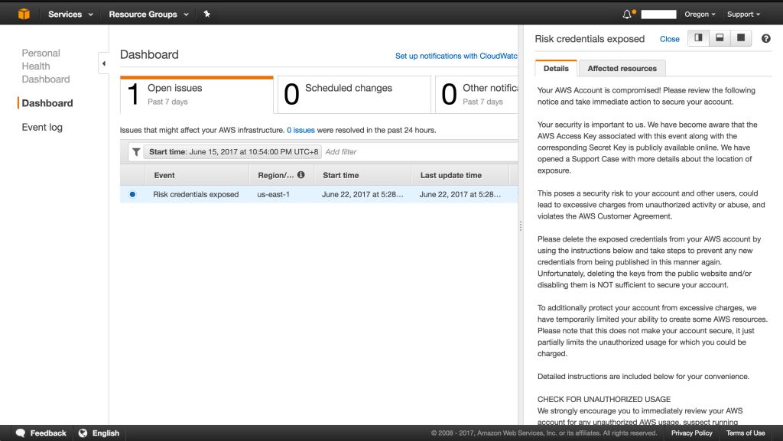
Why is security analytics important? What are its benefits?
Security analytics is important because it allows you to detect threats before they impact your system.
This Photo by Unknown Author is licensed under CC BY-NC-ND

Slide 6
Benefits
Monitoring: This is like having security cameras in your AWS environment. AWS continuously collects data about your cloud resources, user activities, and network traffic. It monitors for any unusual or potentially malicious behavior.
Analysis: Just like a security team reviewing footage from the cameras, AWS uses algorithms and rules to analyze the collected data. It looks for patterns or signs of security threats, such as unauthorized access attempts, data breaches, etc..
Alerts: When AWS detects something suspicious, it sends alerts to notify you.
Investigation: Once alerted, you or your security team can investigate further to understand the nature and severity of the threat
Response: After investigating, you can take action to mitigate the threat. This might involve blocking suspicious traffic, revoking access to compromised accounts, etc..
Improvement: You can use the insights gained from each incident to improve your overall security posture. This can include adjusting security policies, updating configurations, or implementing additional security measures.

Slide 7
What are the challenges of security analytics?
Data assessment : For a solution to work properly, you must be able to handle structured and unstructured data to arrive at an accurate assessment.
Identifying attack patterns: Attackers are becoming more dynamic, using increasingly complex techniques and tactic.

Slide 8
Who uses security analytics?
The Security Operations team consisting of analysts, engineers, and other frontline members use security analytics the most.

Slide 9
What are the AWS offerings for security analytics?
AWS security analytics solutions include the following:
Amazon OpenSearch Service
Amazon GuardDuty
Amazon Detective
Amazon Inspector
Amazon CloudTrail
AWS Security Hub
Amazon Security Lake

Slide 10
Thank you!!

